Slide 1
Redes Neurais Convolucionais
Isaac Sacramento
Doutorando em Ciência da Computação
Universidade Federal de Santa Catarina
Adventure Works: The ultimate source for outdoor equipment

Slide 2
Sumário
Conceitos
Redes Neurais
Deep Learning.
Redes Neurais Convolucionais
Motivação
Convolução
Downsampling
Estrutura
Principais Aplicações
Classificação.
Increased customer satisfaction.
Potêncial de aplicação em geo-estatística

Slide 3

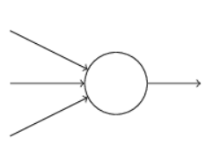

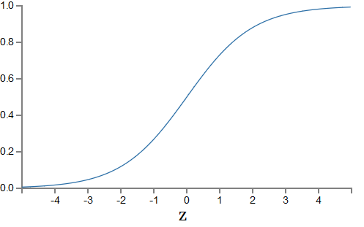


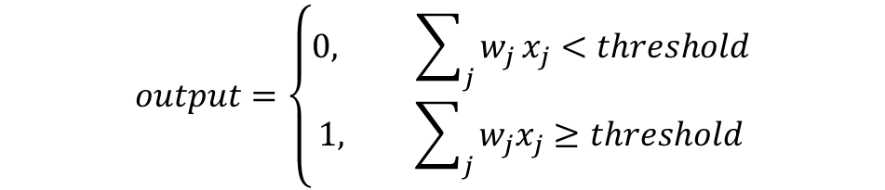


Redes Neurais
O neurônio: Perceptron x Sigmoid
$$σ\left(z\right)=\frac{1}{1+ e^{−z}}$$
b
w1
$$z= \sum_{j}{w_{j}}x_{j}+b$$
w2
w3
$$output=\left\{\begin{aligned}0, \sum_{j}{w_{j}}x_{j}<threshold \\ 1, \sum_{j}{w_{j}x_{j}}≥threshold\end{aligned}\right.$$
$$output=\left\{\begin{aligned}0, w_{}∙ x+b<0 \\ 1, w ∙ x+b≥0\end{aligned}\right.$$

Slide 4
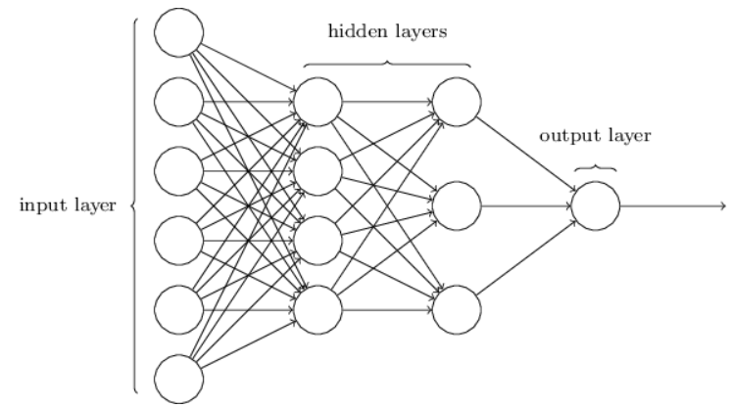
Redes Neurais (arquitetura)
b
w1
w2
w3

Slide 5
Deep Learning
O verdadeiro desafio da IA
Resolver tarefas realizadas facilmente por pessoas, mas difíceis de serem formalizadas.
Reconhecimento de voz
Reconhecimento de faces
Aprendizado por hierarquia de conceitos
Aprendizado de conceitos complicados a partir de conceitos simples

Slide 6
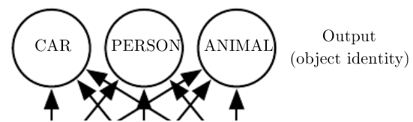
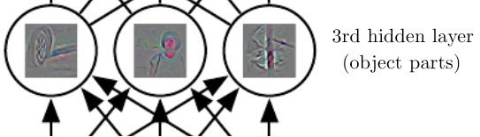

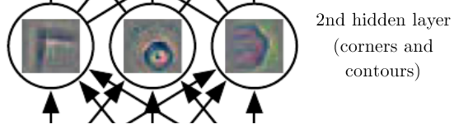
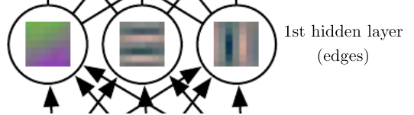
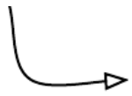
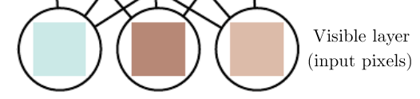
Deep Learning

Slide 7
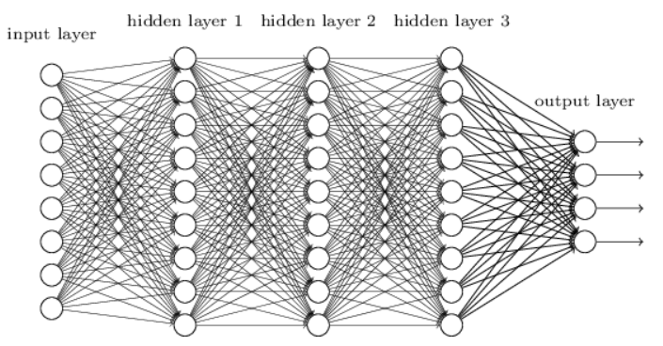
O que muda nas redes convolucionais
Problema?
Pixels que estão próximos e distantes são tratados juntos;
Por que não tirar vantage da estrutura especial das imagens?

Slide 8
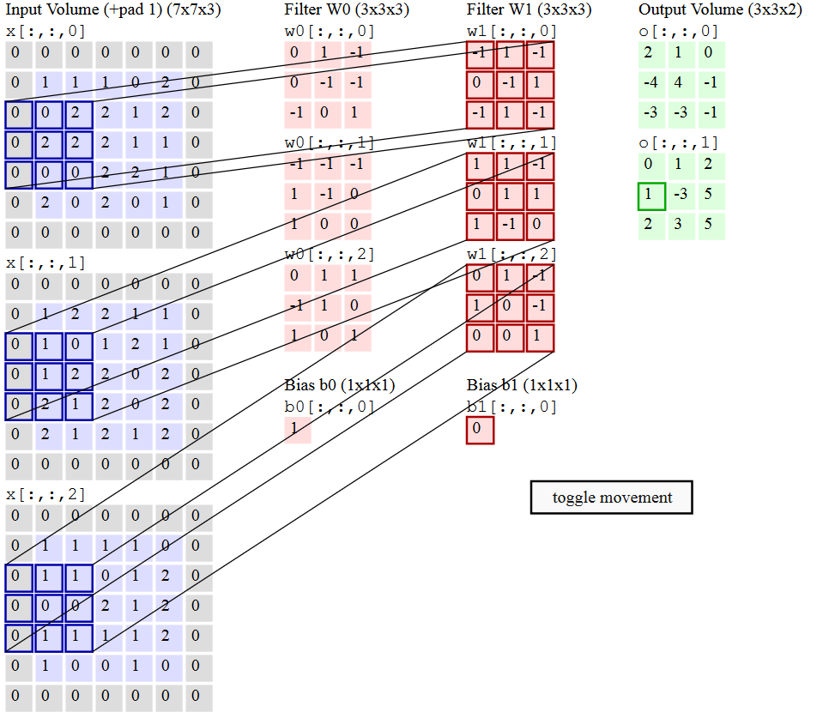
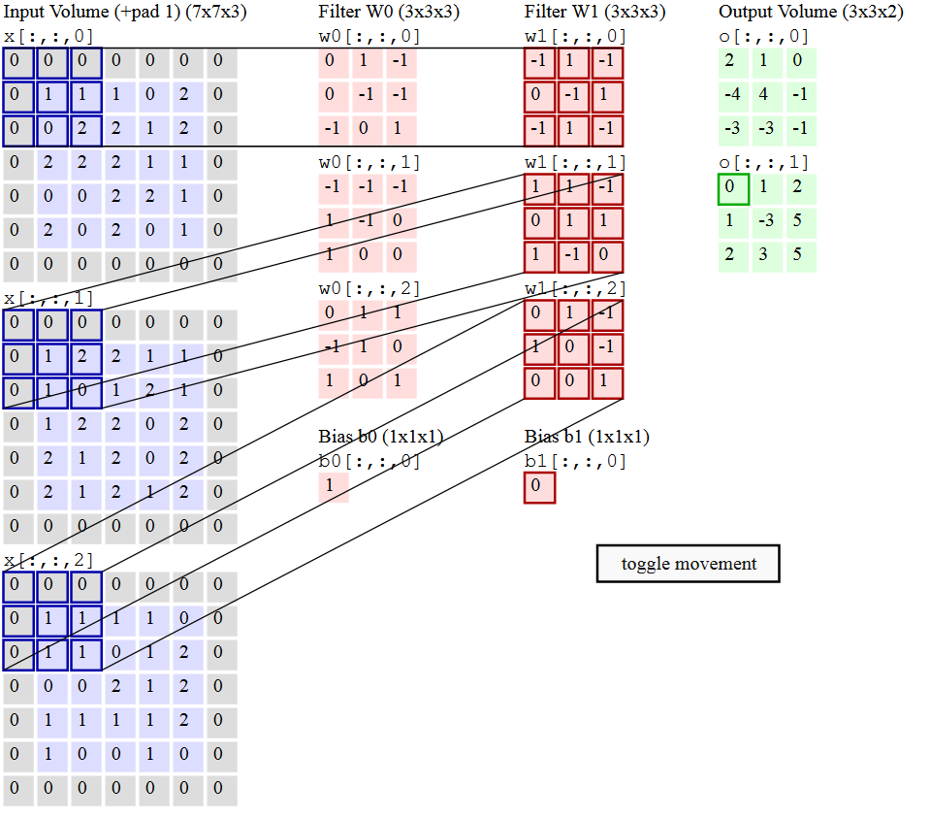
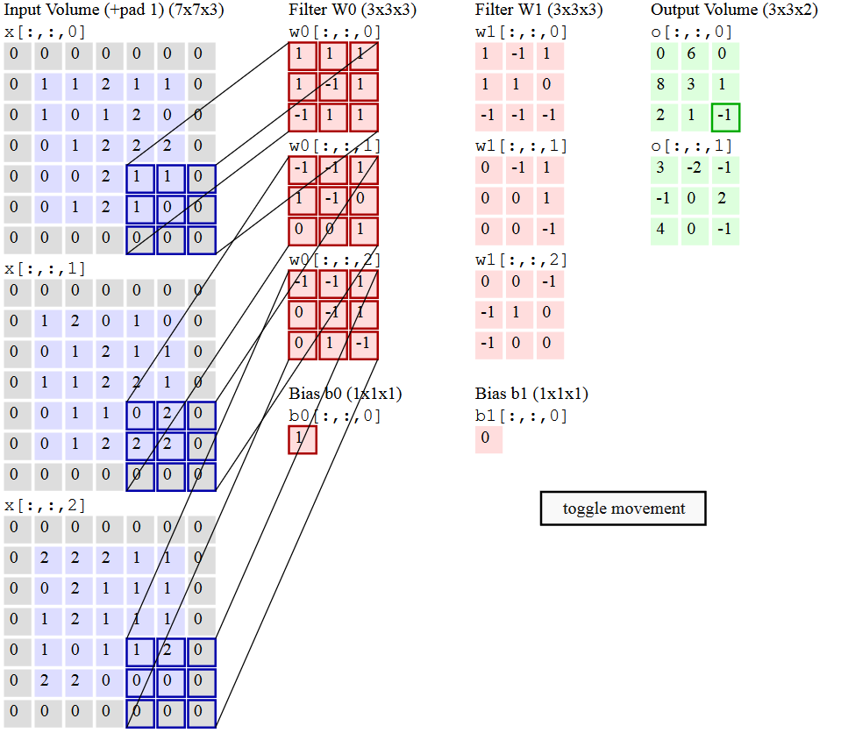
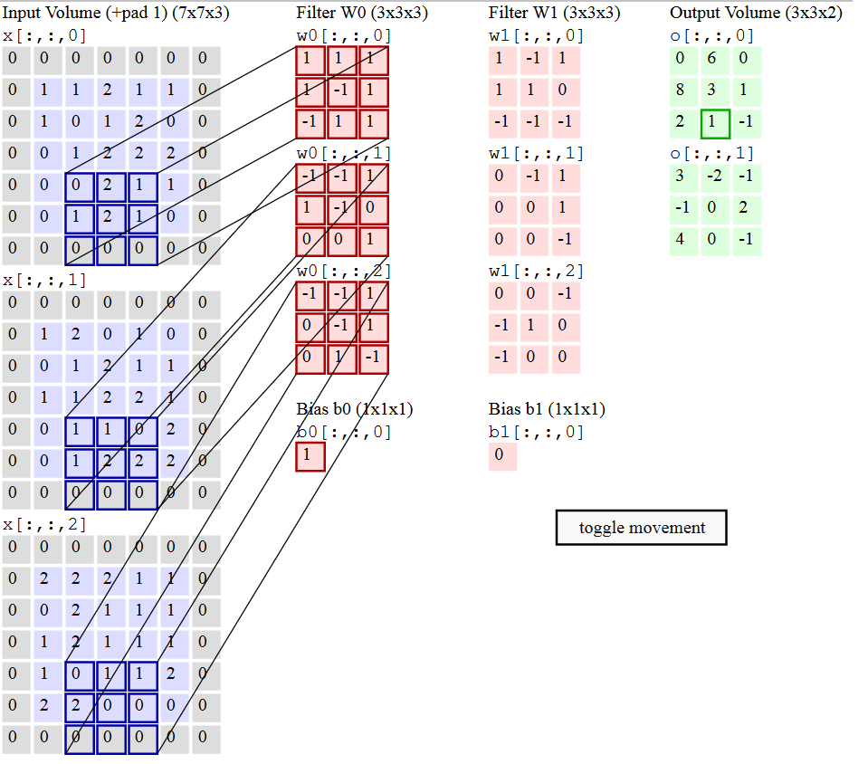
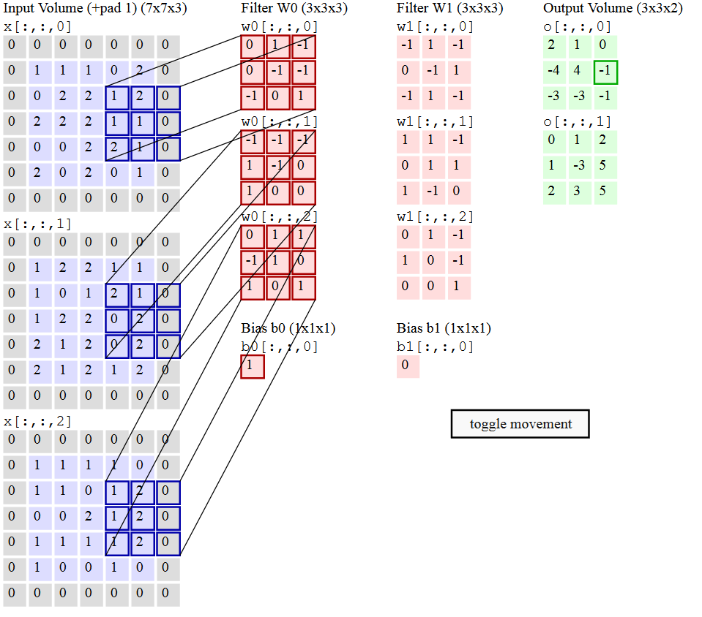
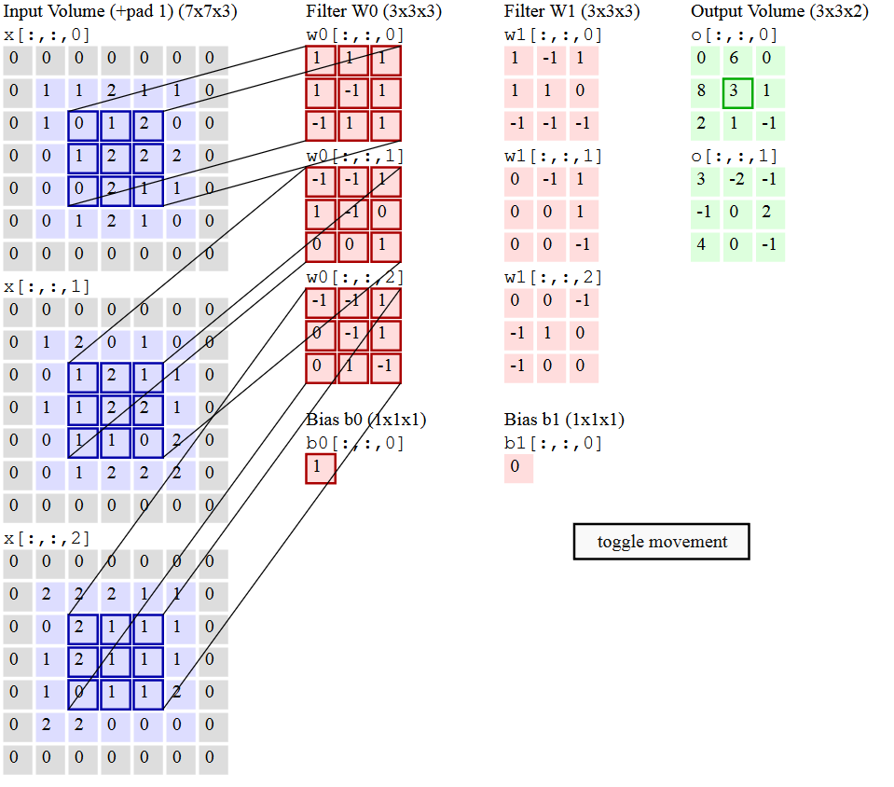
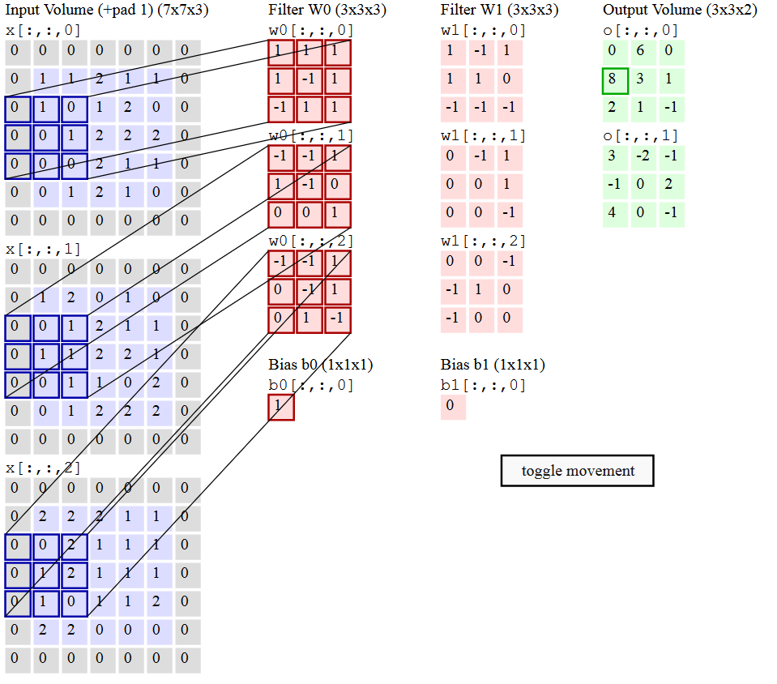
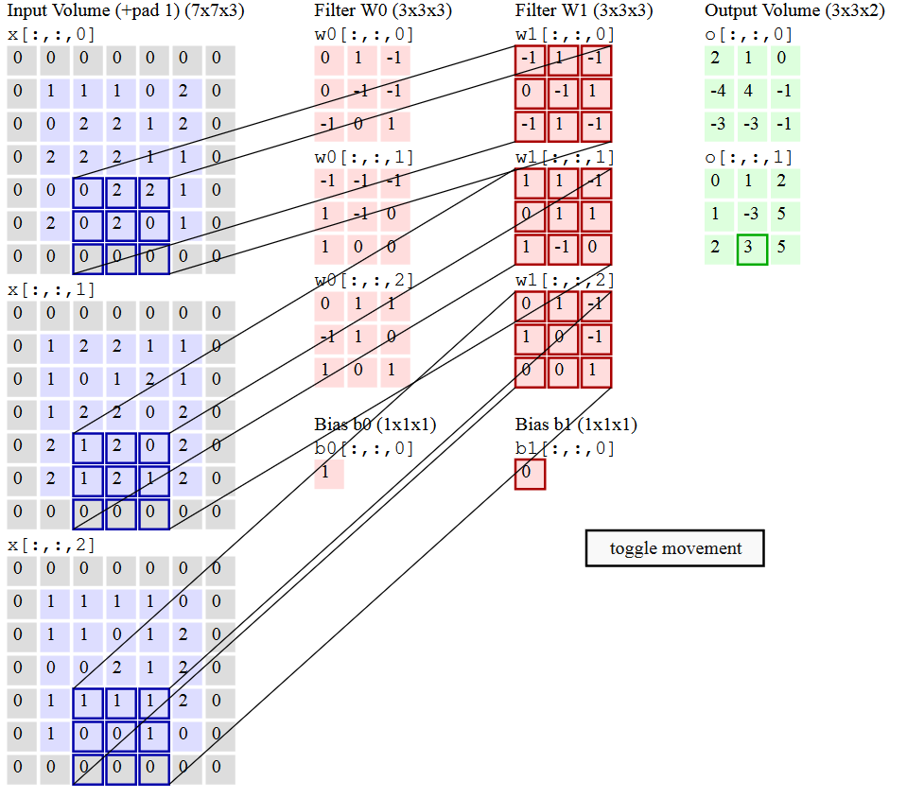
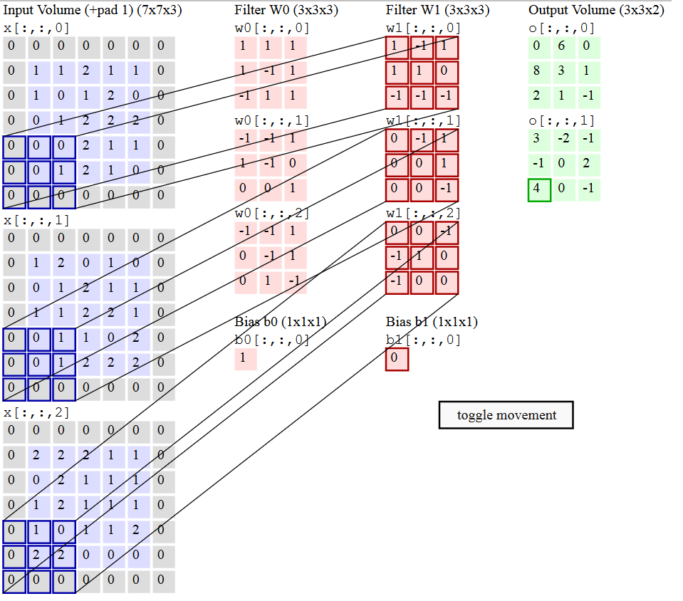
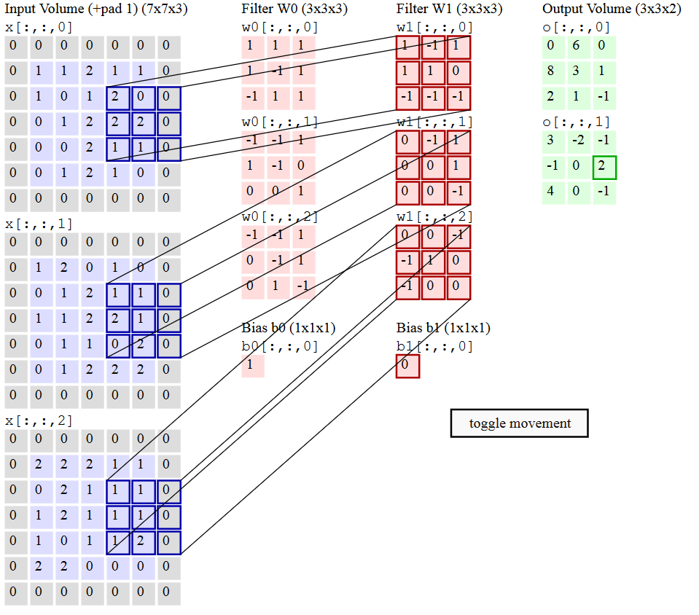
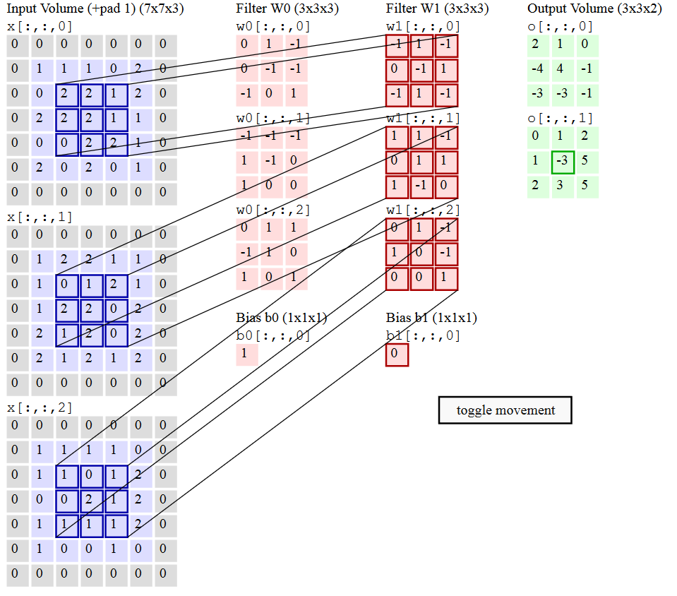
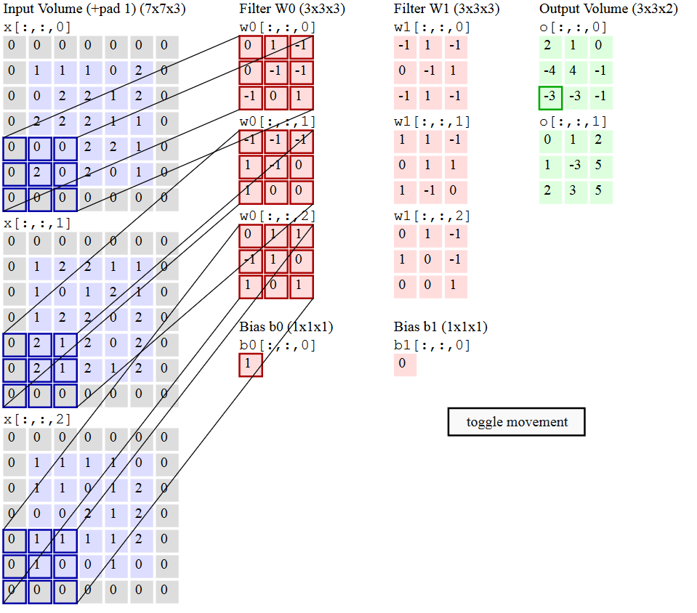
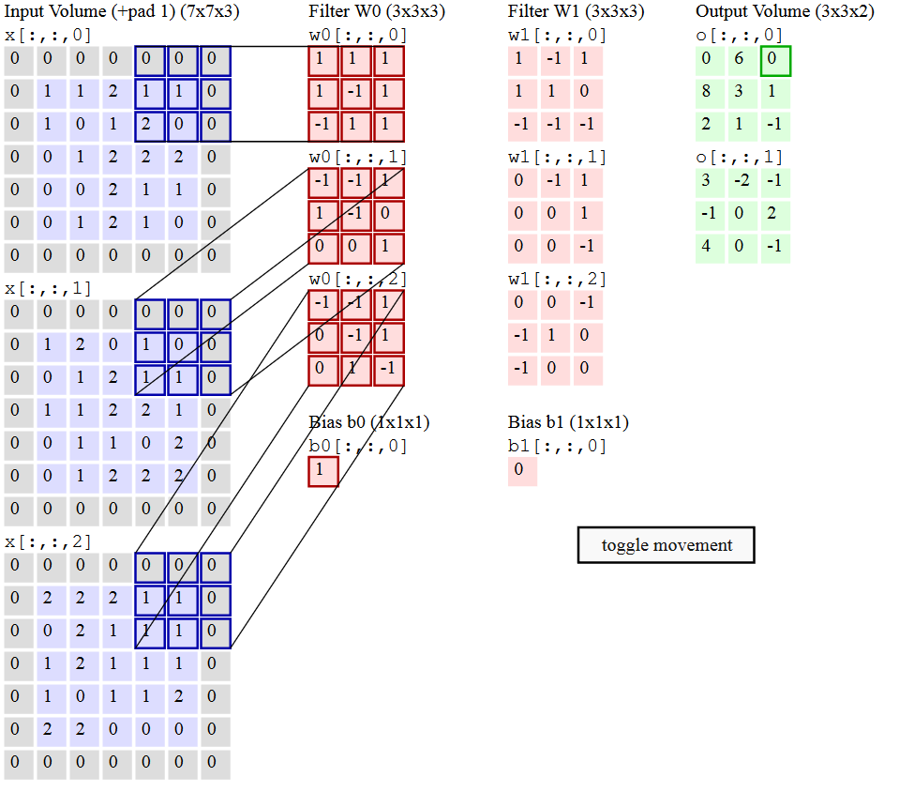
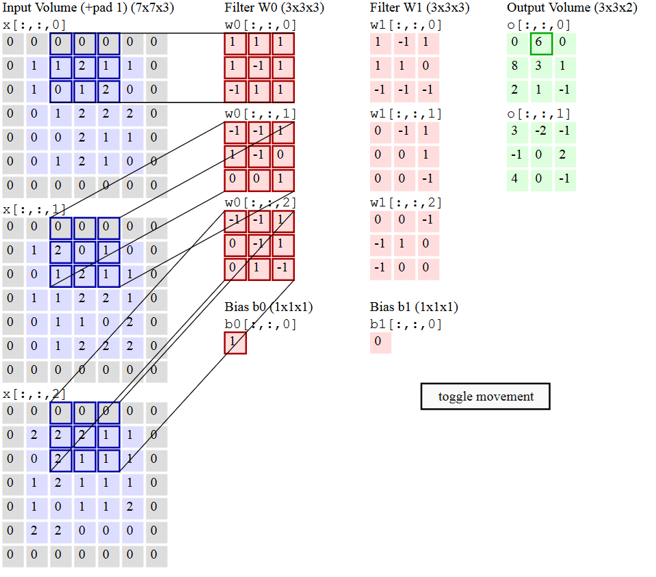
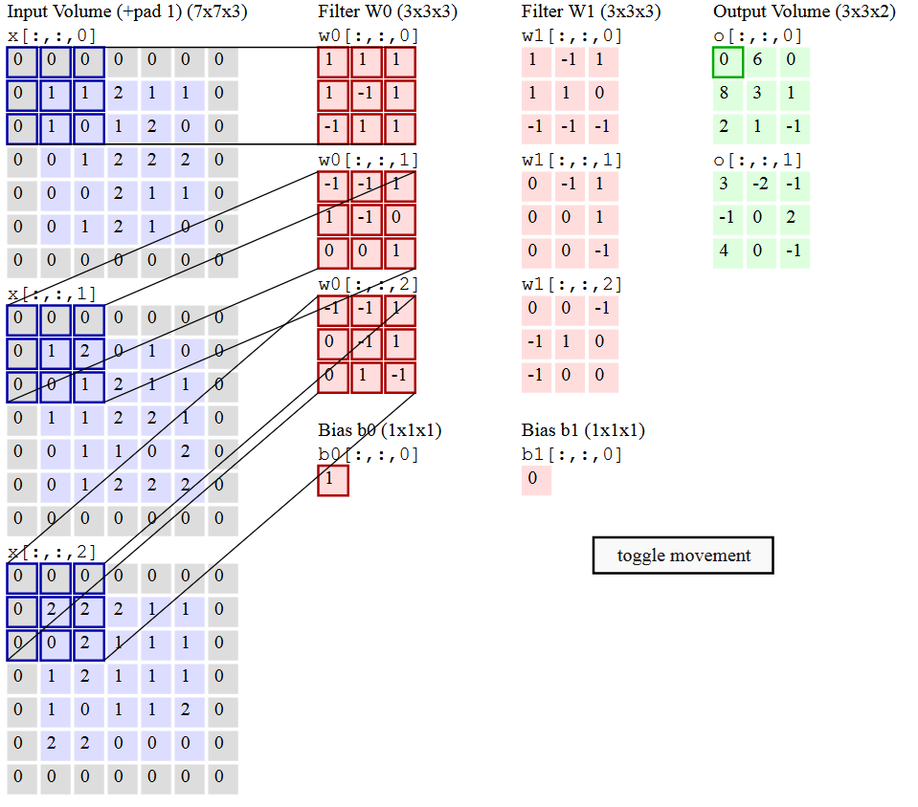
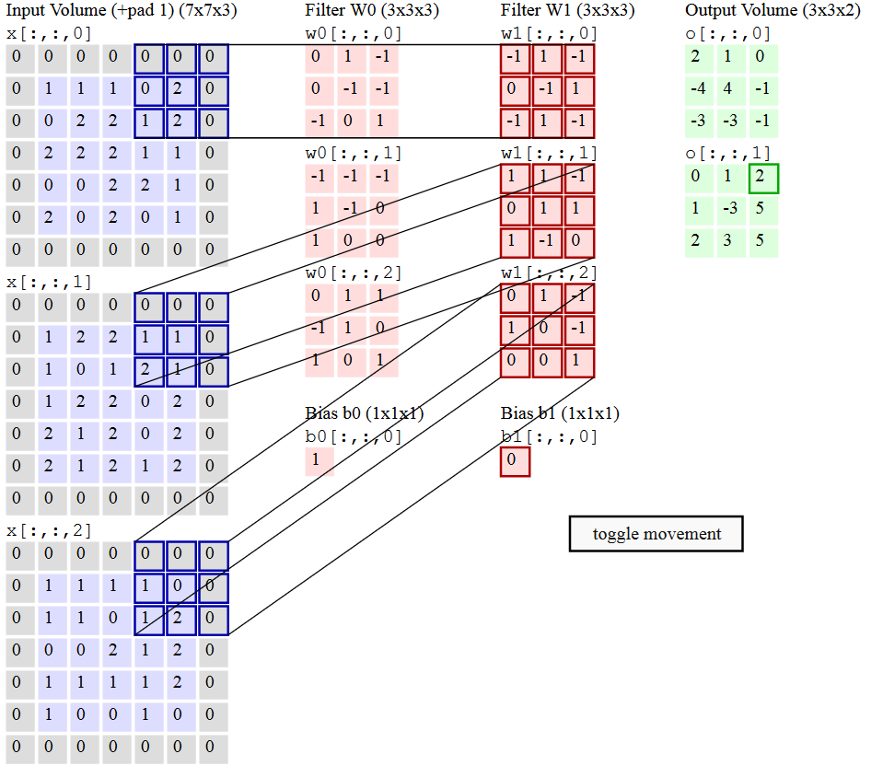
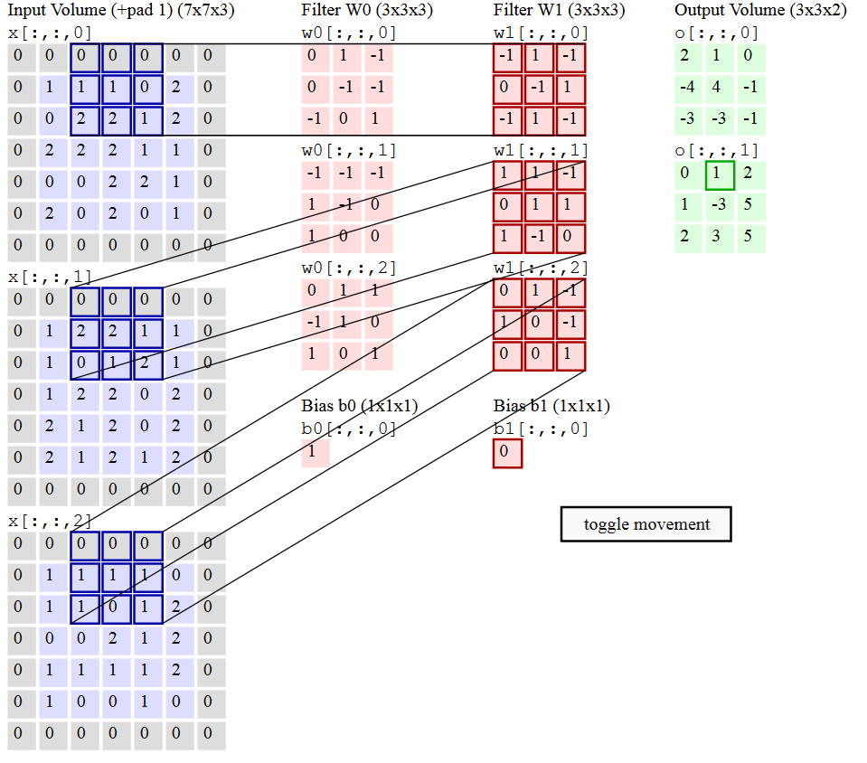
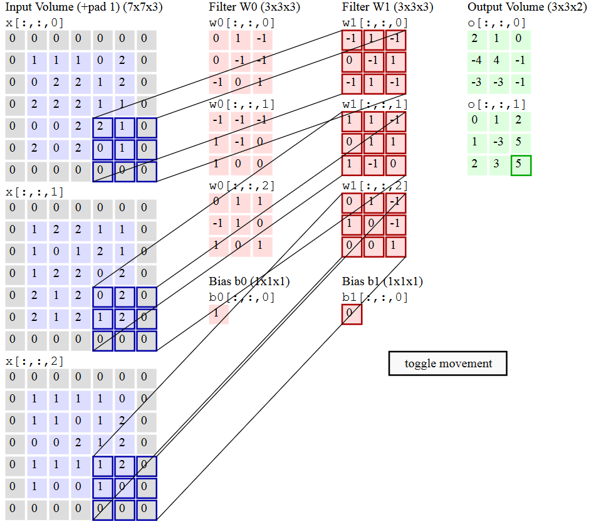
Como funciona a convolução

Slide 9
Proposed New Products
Survival gear
Sportswear
Outerwear
Off-road bicycles
Fishing equipment and tackle
Canoes and personal rowing shells

Slide 10
Costs of Return on Investment Projections
Costs
ROI

Slide 11
Terms and Conditions
Terms and conditions #1
Terms and conditions #2
Terms and conditions #3
Terms and conditions #4
Terms and conditions #5

Slide 12
Strategy and Schedule
Strategy
Tactic #1
Tactic #2
Tactic #3
Schedule
Adopt plan
3Q [Year]
Implement
4Q [Year]
Evaluate
3Q [Year]
Adjust
4Q [Year]

Slide 13
Sales and Marketing Needs
Close sales faster.
Present complex concepts quickly and clearly.
Leverage database information (sales numbers, customer locations, etc.).

Slide 14
Close Sales Faster
Need and solution #1
Need and solution #2
Need and solution #3
Need and solution #4
Need and solution #5

Slide 15
Present Complex Concepts Quickly and Clearly
Need and solution #1
Need and solution #2
Need and solution #3
Need and solution #4
Need and solution #5

Slide 16
Leverage Database Information
Need and solution #1
Need and solution #2
Need and solution #3
Need and solution #4
Need and solution #5

Slide 17
Questions and Answers

Slide 18
Adventure Works: The ultimate source for outdoor equipment

